Slide 1
HLS
Tyler Gillette
Maheshwar Ravuri

Slide 2
Why did we choose this protocol?
Was the most popular streaming protocol prior to Googles DASH protocol.
Neat use of the HTTP protocol.
Interesting to know how Netflix, Youtube and other popular streaming services deliver data to customers.
Anyone on an apple device uses this protocol daily to consume media content.

Slide 3
How does it compare to protocols covered in class?
HLS is similar to RTP (Real-Time transport) which usually runs on UDP.
RTP breaks up the media into chunks, encloses them in a UDP segment and then passes them to HTTP.
Both protocols work on HTTP and can work with firewalls or proxies that allow standard HTTP.
Differences: HLS is built on TCP and RTP is built on UDP.
HLS has an easier time traversing firewalls, while UDP has an easier time traversing NAT’s (Network Address Translation).

Slide 4
Background 1
Supports Live broadcasts and prerecorded content ( VOD )
Intelligent switching of streams in response to network bandwidth changes.
Safari, Chrome, Edge, FireFox, QuickTime, VLC Media Player, Kodi, Roku
HLS was developed by Apple and intended to replace the company’s own media streaming standard Quicktime Streaming for mobile devices.
First generation iPhone (iPhone 3G)
Source: Wikipedia, https://en.wikipedia.org/wiki/HTTP_Live_Streaming
Apple, https://developer.apple.com/documentation/http_live_streaming

Slide 5
Background 2
HLS was released in 2009.
HLS is also know as HTTP Live Streaming.
It was the most popular streaming format.
Its based on standard HTTP transactions.
Although robust it’s getting deprecated
Source: Wikipedia, https://en.wikipedia.org/wiki/HTTP_Live_Streaming

Slide 6
Technical Details 1
It works by breaking the overall stream into a sequence of small HTTP-based file downloads, each downloading one short chunk of an overall potentially unbounded transport stream.
HLS streams are usually split into 10 second chunks which are then stored as .ts files.
Support for 4k HDR using HEVC, HDR10 and Dolby Vision
Source: Wikipedia, https://en.wikipedia.org/wiki/HTTP_Live_Streaming

Slide 7
Technical Details 2
Can support DRM content, because AES-128 is supported.
Supports Low-latency streams, which favors stream latency over reliability.
HLS supports many features using tags inside the .tl files.
Closed Captions, Fast forward and rewinding,
alternative audio and video, fallback alternatives,
timed metadata, ads,
content protection and more.
Source: Wikipedia, https://en.wikipedia.org/wiki/HTTP_Live_Streaming
Apple, https://developer.apple.com/streaming/

Slide 8
Server / Client
Server:
Pre-recorded: Responsible for media input streams encoding, distribution over HTTP.
Live: media stream encoding, breaking the stream into segments and storing them as files, distribution over HTTP.
Client:
Responsible for media request, downloading, reassembling and playing files.

Slide 9
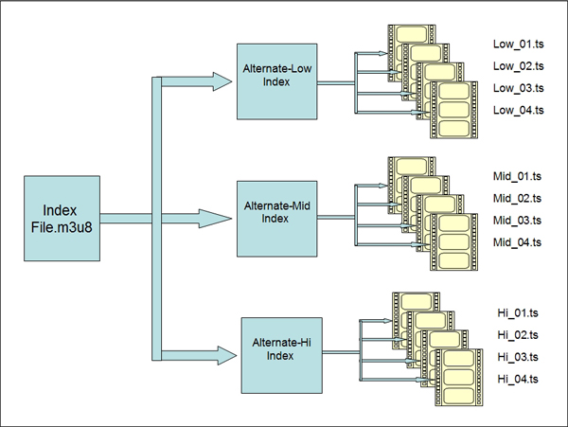
Source: Streaming Media

Slide 10
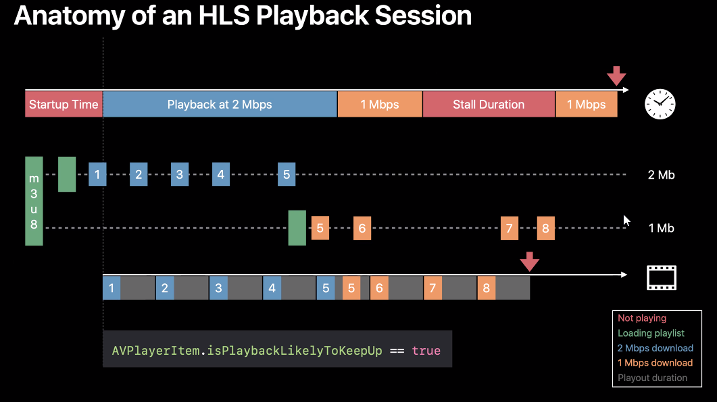

Slide 11
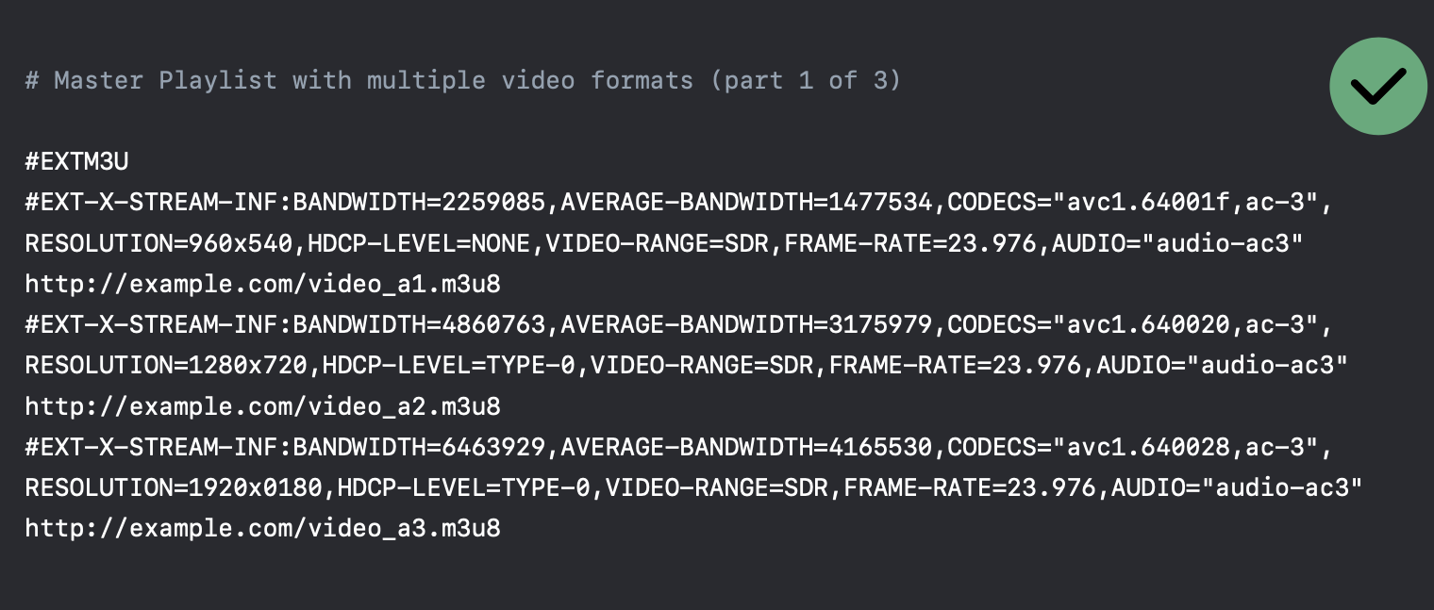

Slide 12
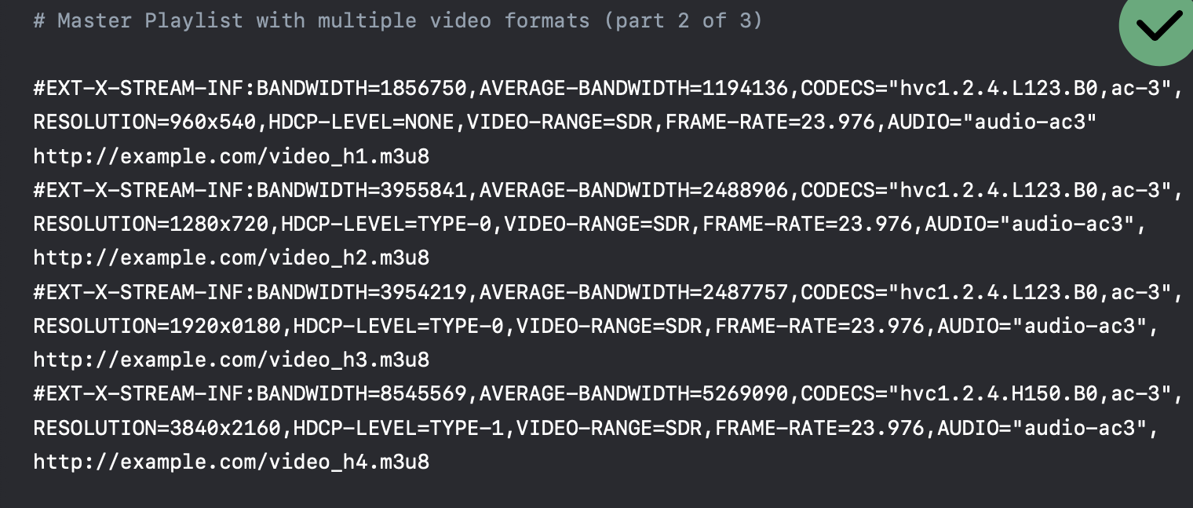

Slide 13
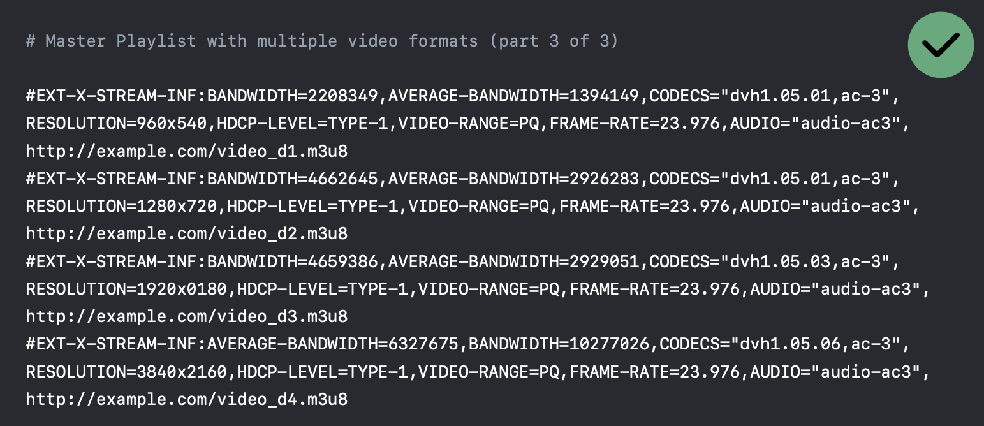

Slide 14
HLS Capabilities

Slide 15
Video
Adaptive bitrate streaming
Live streams, and VOD
4K, HLG, HDR 10, Dolby Vision content
DRM content
H.264/AVC or HEVC/H.265 encoding
fMP4 (Fragmented MP4)
Audio
Lossy and Lossless
MultiChannel formats
2 , 2.1, 5.1, 7.1
Subtitles

Slide 16
Closed Captions,
Fast forward and rewinding,
alternative audio and video, fallback alternatives,
timed metadata, ads,
content protection and more.

Slide 17
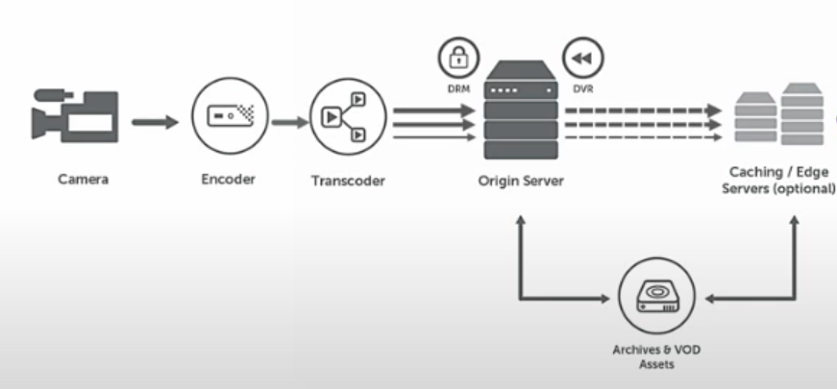
Live streaming workflow
Notes:
Cloudfront

Slide 18
DRM Compliance Using Fairplay

Slide 19
Encryption & Security
Uses AES-128 encryption
Which Encrypts data in 128 block increments and is today's current standard for encryption.
The sender can encrypt the whole stream with one key or each individual file with a different key.
HTTPS (Hyper-Text Transfer Protocol) which is using an SSL (Secure Socket Layer) certificate.
Password protect the video files.

Slide 20
Limitation / Future trends
Strict video format requirements.
High Latency, for small duration chunks, finding a right balance can be hard.
HLS Protocol is limited by the hardware of the device.
Low-Latency HLS had just been released by apple in 2019 to address the issue, which in turn lowers the delay of the livestreams.

Slide 21
Conclusion
HLS Was the most popular media streaming protocol, prior to Google releasing the mpeg-DASH protocol which is codec agnostic.
HLS & DASH have Adaptive Bitrate Streaming based off the available bandwidth.
Media encryption and user authentication make HLS a secure media streaming protocol.

Slide 22
References
Wikipedia:
https://en.wikipedia.org/wiki/HTTP_Live_Streaming
Apple.com:
https://developer.apple.com/library/archive/referencelibrary/GettingStarted/AboutHTTPLiveStreaming/Art/stream_playlists_2x.png
https://developer.apple.com/documentation/http_live_streaming
https://developer.apple.com/streaming/
Streaming Media:
https://www.streamingmedia.com/Articles/Editorial/What-Is-.../What-Is-HLS-(HTTP-Live-Streaming)-78221.aspx?utm_source=related_articles&utm_medium=gutenberg&utm_campaign=editors_selection#:~:text=At%20a%20high%20level%2C%20HLS,logic%20resides%20on%20the%20player.

Slide 23
DEMO

